Slide 1
PREDICTION OF INSURANCE PREMIUM
Presented by : Vinod A. Korachgaon Batch : DA172S17+ML22S2 Client : Komilla Bhatia Date : 05-03-2024

Slide 2
Objective :
Using Machine Learning Algorithm predict health insurance charges based on individual characteristics
Description of the Dataset :
The Insurance dataset has 1337 rows and 8 columns . It provides information on Peoples Age ,Gender , BMI , Health Status , Children , Smoking status , Region , Insurance Charges

Slide 3
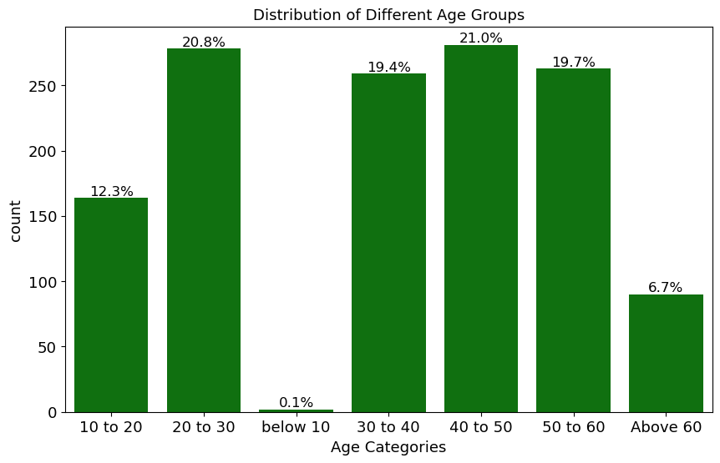
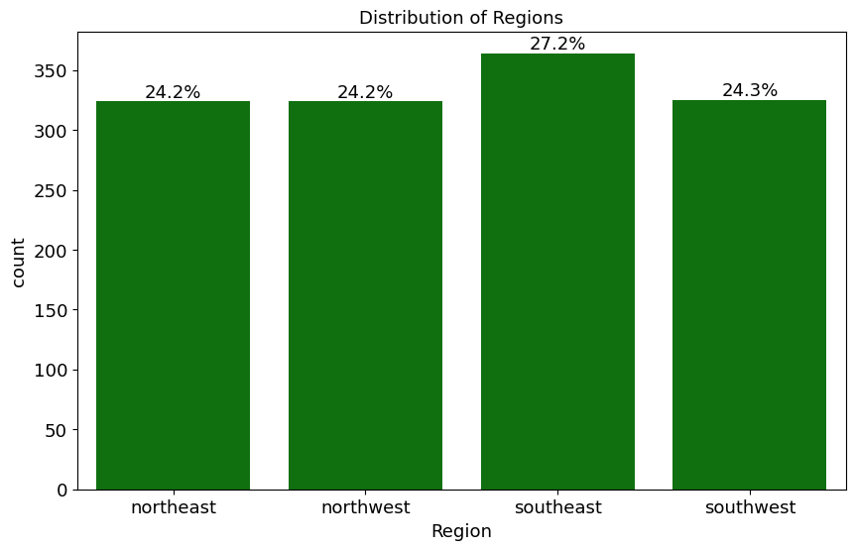
Distribution of Different Age Groups
Ratio of the Different Regions
40-50 years: 21% of the population
20-30 years: 20.8% of the population
Southeast people are more : 27.2%
Southwest people are : 24.3%

Slide 4
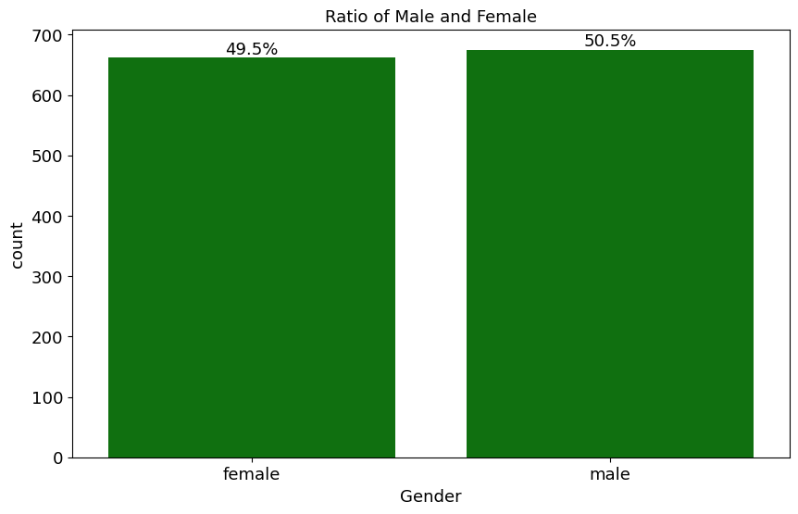
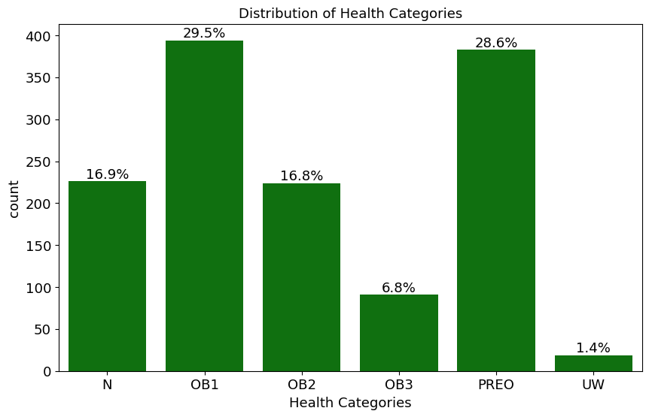
Ratio of Male and Female in the dataset
Distribution of different Health Categories
Males a : 50.5%
Females : 49.5%
People with Obesity level 1 are more: 29.5%
People with Preoperative health status are :28.6%

Slide 5
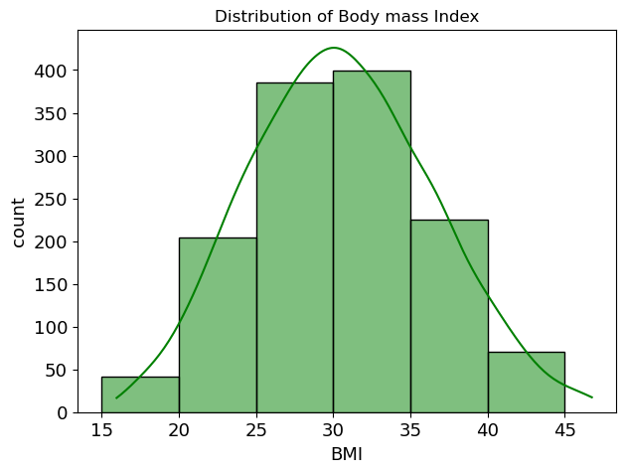
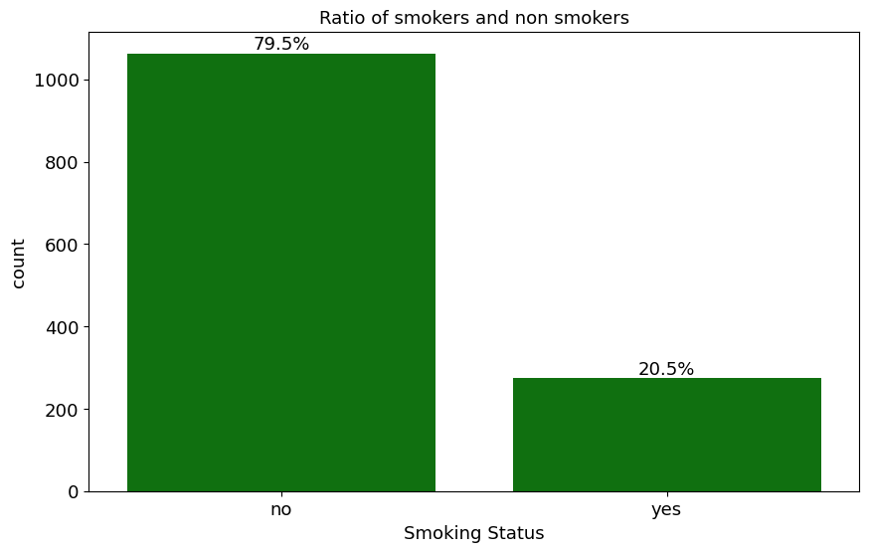
Distribution of BMI
Ratio of smokers and non smokers
People with Bim range 25-35 are more
Non smokers : 79.5%
Smokers : 20.5%

Slide 6
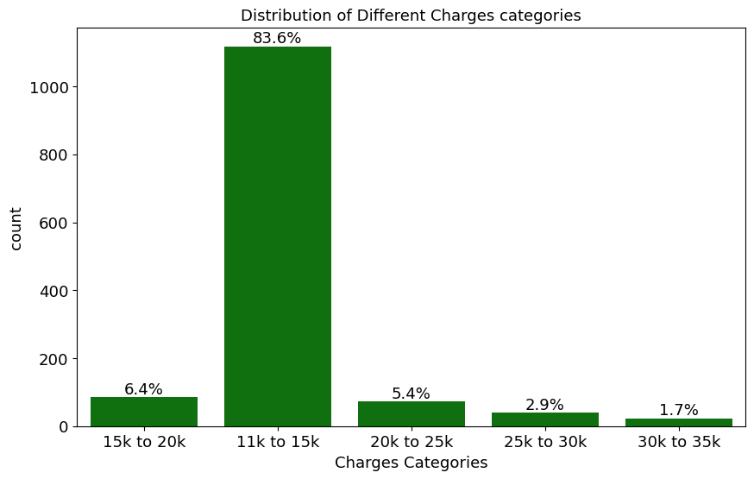
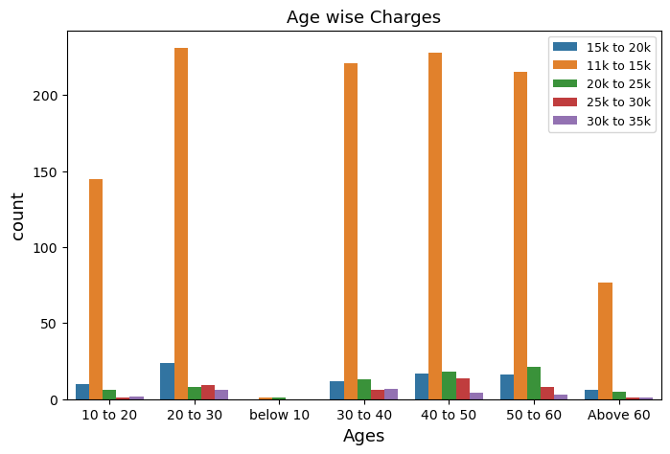
Distribution of different charges categories
Age wise Insurance Charges
Many people in the data have insurance costs from 11k to 15k
People aged between 20 - 30 ,40-50,30-40 and 50-60 pay more for insurance, mostly between 11k and 15k

Slide 7
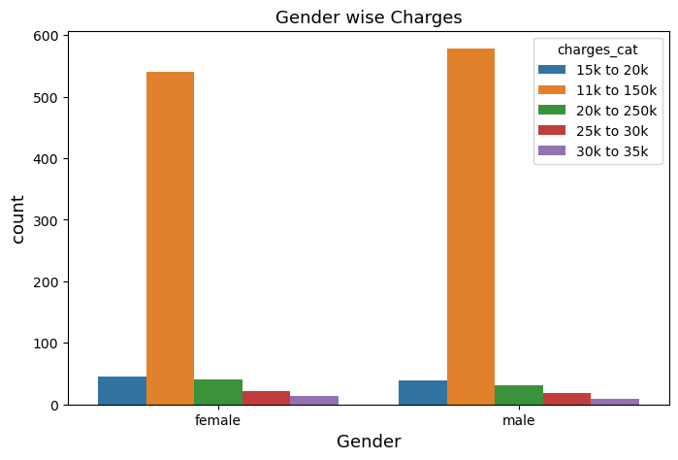
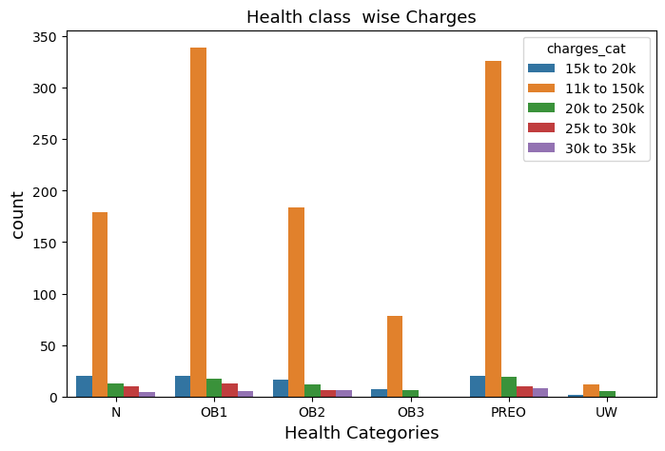
Gender wise Insurance Charges
Different Health category wise Insurance Charges
Both Females and males pay insurance mostly between 11k-15k
People with Obesity level 1 and Preoperative health status are pay insurance more between 11k-15k

Slide 8
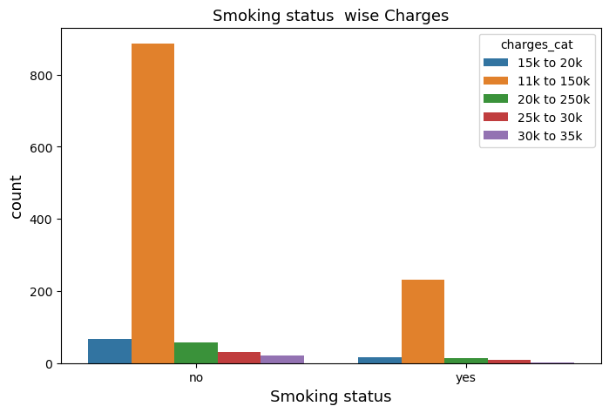
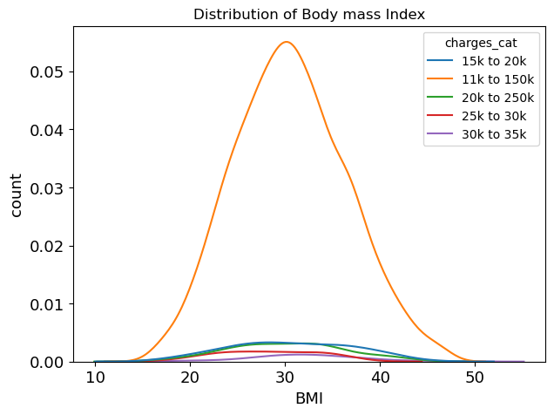
Smoking status wise Insurance Charges
BMI wise Insurance Charges
Non Smoking Peoples are pay more insurance
between 11k to 15k
People with BMI Range between 25-30, pay more insurance between 11k – 15k

Slide 9
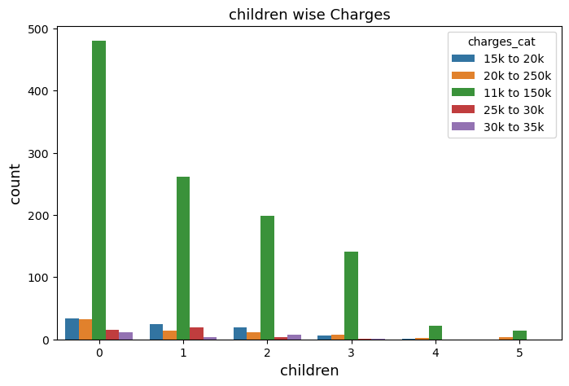
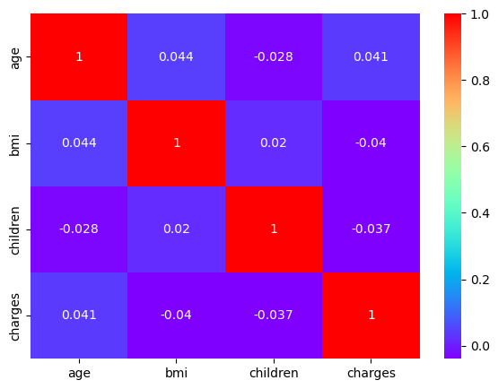
Children count wise Insurance Charges
Correlation of the dataset
People who don’t have children they pay insurance more between 11k -15k
There is no correlated column in the dataset
Bmi and age Weak Positive correlation (0.044)
Charges and Age Weak positive correlation(0.041)
Bmi Charges Weak Negative Correlation (-0.04)

Slide 10
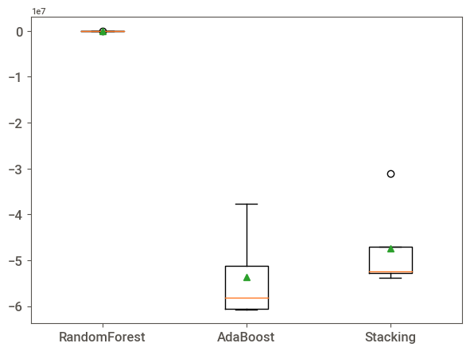
Algorithms Linear Regression Bagging – Random Forest Boosting – Adaboost Stacking | Performance Training:94% - Overfitting occurred Testing : 5436 Training : 84% Testing : 5513 Cross Validation mean: -5326 Training : 26% Testing : 5787 Cross Validation Mean : -53689095 Training: 7% Testing : 5393 Cross Validation mean : -47416325 | Conclusion Overfitting problem occurred Reduced overfitting Good Performance Underfitting problem occurred Training Performance is very poor
More Reliable Performance
Random Forest is More reliable
Tried Feature selection with Random Forest and Hyperparameter both to get more good performance were giving even more bad performance compare to Random forest without feature selection and hyperparameter so I am going with random forest

Slide 11
Analyse
40-50 years: 21% of the population
Southeast people are more : 27.2%
Males a : 50.5%
Females : 49.5%
People with Obesity health status level 1 are more: 29.5%
People with Bim range 25-35 are more
Non smokers : 79.5%
Smokers : 20.5%
Many people in the data have insurance costs from 11k to 15k
Summary
People aged between 20 - 30 ,40-50,30-40 and 50-60 pay more for insurance, mostly between 11k and 15k
Both Females and males pay insurance mostly between 11k-15k
People with Obesity level 1 and Preoperative health status are pay insurance more between 11k-15k
Non Smoking Peoples are pay more insurance
between 11k to 15k
People with BMI Range between 25-30, pay more insurance between 11k – 15k
Used Machine Learning Algorithm in python
to predict health insurance charges based on individual characteristics for the Future data
C O N C L U S I O N

